Slide 1
In-Depth Analysis of Telecom Subscriber Behavior
Leveraging PCA and Clustering for Strategic Insights
Presented by: Nurly Kuzdikbay

Slide 2
Introduction
Dataset Overview:
Description: Analysis of telecom subscriber data including features like revenue, call minutes, and data usage.
Timeframe: Data from two specific months (e.g., August and September) are compared.
Goals of the Analysis:
To explore subscriber behavior through PCA (Principal Component Analysis) and KMeans clustering.
To identify distinct subscriber segments based on their usage and spending patterns.
Significance of the Analysis:
Deep insights into subscriber behavior enable the development of more precise and effective marketing strategies. They also facilitate the refinement of service offerings, directly enhancing customer satisfaction and fostering stronger loyalty.

Slide 3
Foundations of Our Analysis: Data Preparation and Methodology
Data Preparation:
Merging data from different time frames (e.g., August and September).
Handling numerical and non-numerical data.
Addressing missing values using mean imputation.
Outlier detection and removal for data consistency.
Analytical Approach:
Standardization: Scaling features to neutralize variance.
Principal Component Analysis (PCA): Reducing dimensions while capturing 95% of variance in data.
KMeans Clustering: Identifying optimal clusters via the Elbow Method; applying KMeans to segment the subscriber base.

Slide 4
Principal Component Analysis
Introduction to PCA: PCA is a statistical technique used to simplify the complexity in high-dimensional data while retaining trends and patterns. It does this by transforming the original variables into a new set of variables, the principal components, which are orthogonal and uncorrelated.
Number of Principal Components (PCs): 8 indicates that seven principal components were retained after applying PCA. This number of components is enough to explain 95% of the variance in your data, given the cumulative sum of the variance explained by these components.
Explained Variance Ratio: The array of values represents the proportion of the dataset's variance that each principal component accounts for. For example, the first principal component (PC1) explains approximately 34.89% of the variance in the dataset, and the second (PC2) explains about 18.90%, and so on. The sum of these values should be close to 0.95 (or 95%), which is the amount of total variance you aimed to capture with PCA.

Slide 5
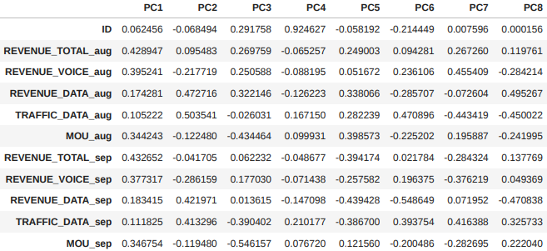
Loadings of original fields
High Spending on Voice and Data: Subscribers with high overall spending likely spend more on voice and data services.
Different Usage Patterns: Data suggests varying subscriber preferences, with some favoring data usage over voice.
Subscriber Segmentation: Analysis could lead to grouping subscribers by their usage and spending habits.
Behavioral Changes Over Time: Comparing monthly data may reveal shifts in subscriber spending habits.
Impact of New Services: Introduction of new services might influence spending and usage patterns among subscribers.

Slide 6
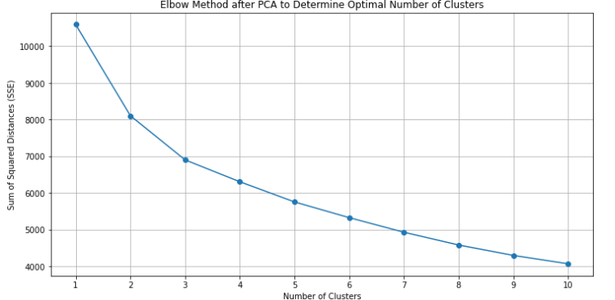
Optimal Cluster Identification with K-Means Clustering
In the Elbow Method graph for determining the optimal number of clusters, the point where the sum of squared distances (SSE) starts to decrease at a diminishing rate is typically chosen as the right number of clusters. This point is referred to as the "elbow" because the SSE plot resembles an arm with an elbow bend.
Upon analyzing the graph, the SSE begins to level off after 3 clusters, indicating that additional clusters do not significantly improve the compactness of the clustering. Consequently, 3 clusters seem to be the most reasonable choice for this dataset, balancing the complexity of the model with the distinctness of the clusters. This selection is based on visual inspection and should be complemented by domain knowledge and additional cluster validation metrics, such as the Silhouette Score, for a more comprehensive evaluation.

Slide 7
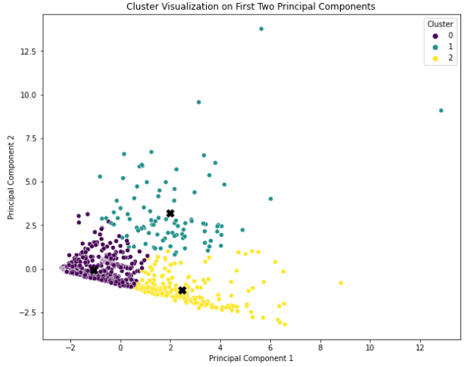
K-means clustering with 3 centroids
Clustering on PCA Data: Apply K-means clustering to the PCA-reduced data to ensure efficiency and clarity in high-dimensional datasets. This step involves initializing centroids, assigning data points to the nearest centroid, and iteratively adjusting the centroids.
Cluster Interpretation: Analyze each cluster's characteristics by examining the central values of the features within the cluster. This helps to identify distinct groups within the data, such as different customer segments based on behavior or preferences.

Slide 8
K-Means Clustering: Results
Cluster 0 (Low Utilization Cluster):
Characteristics: This cluster has negative mean values for almost all features, indicating lower usage and expenditure across the board compared to the other clusters.
Hypothesis: Subscribers in this cluster might represent a segment with minimal usage or lower engagement with services. They might be more cost-conscious or occasional users.
Conclusion: Targeting this group could involve strategies to increase engagement or upsell additional services.
Cluster 1 (High Spending on Voice Services Cluster):
Characteristics: This cluster shows particularly high mean values for REVENUE_VOICE_sep, REVENUE_TOTAL_aug, and TRAFFIC_DATA_aug, indicating significant spending on voice services and high data traffic in August.
Hypothesis: Subscribers in this cluster are likely heavy users of voice services and possibly have a higher willingness to pay for these services.
Conclusion: This segment could be targeted with premium voice service packages or loyalty rewards to maintain their high usage levels.
Cluster 2 (High Data Usage Cluster):
Characteristics: Exhibits high mean values for REVENUE_DATA_aug, TRAFFIC_DATA_sep, and MOU_sep, suggesting high expenditure on data services and significant data traffic.
Hypothesis: These subscribers are possibly heavy internet users, likely utilizing data-intensive applications.
Conclusion: Offering data-centric plans or promotions, especially for high-speed or unlimited data, could appeal to this segment.

Slide 9
Future suggestions for analysis
Advanced Clustering Techniques: Beyond K-means, methods like hierarchical clustering or density-based spatial clustering (DBSCAN) could provide deeper insights.
Dynamic PCA: Utilizing a rolling window for PCA could capture changes in behavior patterns over time more accurately.
Longitudinal Analysis: Tracking the same subscribers over an extended period could reveal long-term trends and shifts in usage.
Integration of Additional Data: Including demographic or psychographic information to enrich the segmentation and provide more targeted insights.
Predictive Modeling: Developing models to predict future spending or usage patterns based on the identified clusters and trends.

